Slide 1
DYNAMIC HOST CONFIGURATION PROTOCOL
(DHCP)

Slide 2
Objectives
Configure network interfaces using command-line and graphical utilities
Set up a simple DHCP server
The Complete Guide to Linux System Administration

Slide 3
HISTORY
DHCP was created by the Dynamic Host Configuration Working Group of the Internet Engineering Task Force
October 1993: RFC 1531 initially defined DHCP as a standard-track protocol succeeding the Bootstrap Protocol (BOOTP), which is a network protocol used by a network client to obtain an IP address from a configuration server
October 1997: RFC 2131 released is the current DHCP definition for Internet Protocol version 4 (IPv4) networks
https://www.rfc-editor.org/rfc/rfc2131
The extensions of DHCP for IPv6 (DHCPv6) were published as RFC 3315

Slide 4
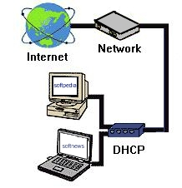
What is DHCP?
Dynamic Host Configuration Protocol
It is a method for assigning Internet Protocol (IP) addresses permanently or to individual computers in an organization’s network
DHCP lets a network administrator supervise and distribute IP addresses from a central point and automatically sends a new IP address when a computer is plugged into a different place in the network

Slide 5
Motivation for DHCP
Configuration parameters for network hosts
  IP address
  Router
  Subnet Mask
  Others..

Slide 6
Two types of IP Addresses
DHCP is used to assign IP addresses to hosts or workstations on the network
Two types of IP addresses:
  Static
    Is a number that is assigned to a computer by an Internet service provider (ISP) to be its permanent address on the Internet
  Dynamic
    The temporary IP address is called a dynamic IP address

Slide 7
Why is DHCP Important?
Important when it comes to adding a machine to a network
When computer requests an address, the administrator would have to manually configure the machine
  Mistakes are easily made
  Causes difficulty for both administrator as well as neighbors on the network
DHCP solves all the hassle of manually adding a machine to a network

Slide 8
How does DHCP work?
When a client needs to start up TCP/IP operations, it broadcasts a request for address information
The DHCP server will not reallocate the address during the lease period and will attempt to return the same address every time the client requests an address
The client can extend its lease or send a message to the server before the lease expires it that it no longer needs the address so it can be released and assigned to another client on the network

Slide 9
Advantages of DHCP
DHCP minimizes the administrative burden
By using DHCP there is no chance to conflict IP address
By using DHCP relay agent you provide IP address to another network

Slide 10
Disadvantages of DHCP
When DHCP server is unavailable, client is unable to access enterprises network
Your machine name does not change when you get a new IP address

Slide 11
Security problem
DHCP is an unauthenticated protocol
  When connecting to a network, the user is not required to provide credentials in order to obtain a lease
  Malicious users with physical access to the DHCP-enabled network can instigate a denial-of-service attack on DHCP servers by requesting many leases from the server, thereby depleting the number of leases that are available to other DHCP clients

Slide 12
Easy to set-up and administer
DHCP servers are easy to administer and can be set-up in just a few minutes
Client addresses are assigned automatically

Slide 13
Limitations
Some machines on your network need to be at fixed addresses, for example servers and routers
You need to be able to assign a machine to run the DHCP server continually as it must be available at all times when clients need IP access

Slide 14
Conclusion
Assigning client addresses automatically is by far the easiest option of the two:
  Set-up automatically by DHCP server
  Set-up manually
To set-up clients automatically all you need to do is set your TCP/IP control panels to receive automatically
If you intend to set up your client computers manually, make sure that the assigned IP address is in the same range of your default router address and that it is unique to your private network

Slide 15
Configuring Linux Networking
Learn more about
  Networking protocols
  Network configuration
The Complete Guide to Linux System Administration

Slide 16
Understanding Network Devices in Linux
Linux networking devices
  Not shown in /dev directory
  Do not “exist” on system until appropriate device driver installed in kernel
Networking device
  Named channel over which network traffic can pass
Device drivers for networking are kernel modules
The Complete Guide to Linux System Administration

Slide 17
Understanding Network Devices in Linux (continued)
Kernel modules can be loaded or unloaded while Linux is running
/dev/eth0
  First Ethernet card installed on system
Media Access Control (MAC) address
  Unique address assigned by Ethernet card manufacturer
The Complete Guide to Linux System Administration

Slide 18
Understanding Network Devices in Linux (continued)
To obtain MAC address
  Host broadcasts message to entire network segment using Address Resolution Protocol (ARP)
  Host with IP address responds directly to computer that sent ARP request with MAC address
  Source host stores MAC address and IP address
The Complete Guide to Linux System Administration

Slide 19
Understanding Network Devices in Linux (continued)
arp command
  Display ARP cache
    Mapping of IP addresses to hardware addresses
  Used mainly for troubleshooting network connectivity
  Refreshed frequently
The Complete Guide to Linux System Administration

Slide 20
Configuring Networking with Command-line Utilities (continued)
View status of interface: ifconfig eth0
Stop Ethernet interface: ifconfig eth0 down
Start Ethernet interface: ifconfig eth0 up
Routing table tells networking software where to send packets that are not part of local network
The Complete Guide to Linux System Administration

Slide 21
Configuring the DNS Resolver
DNS
  Used to convert host and domain names into IP addresses
  Implemented by server that supports DNS
Reverse DNS converts IP address to domain name
Resolving
  Process of converting domain name to IP address or vice versa
The Complete Guide to Linux System Administration

Slide 22
Configuring the DNS Resolver (continued)
Resolver
  Client part of DNS
  Makes requests to DNS server
  Test by pinging another system using host name instead of IP address
  Configured by file /etc/resolv.conf
  Contains IP address of one or more DNS servers preceded by keyword nameserver
  Can include up to three DNS servers
The Complete Guide to Linux System Administration

Slide 23
Configuring the DNS Resolver (continued)
Keyword
  Word to which program reading configuration file attaches special meaning
Utilities for researching DNS problems:
  dnsquery – whois
  nslookup – host
  dig
/etc/hosts file stores IP addresses and corresponding domain names in text file on host
The Complete Guide to Linux System Administration

Slide 24
Dynamic Routing with Routing Protocols
Static routing
  Uses preconfigured routing table
  Not good choice for:
    Larger networks
    Unreliable connections
Dynamic routing uses specialized routing protocol to build and modify routing tables automatically
The Complete Guide to Linux System Administration

Slide 25
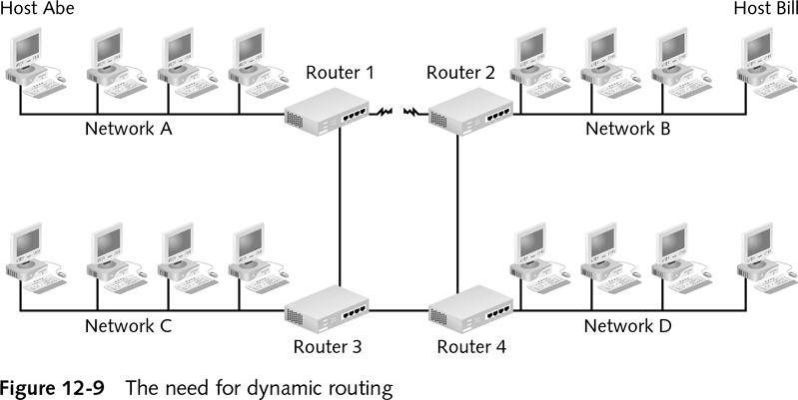
Dynamic Routing with Routing Protocols (continued)
The Complete Guide to Linux System Administration

Slide 26
Configuring a DHCP Server
DHCP server installed by default on many Linux systems
/etc/dhcpd.conf file
  Configuration for DHCP
  Instructs DHCP server which IP address ranges are available for DHCP clients
The Complete Guide to Linux System Administration

Slide 27
Configuring a DHCP Server (continued)
When client requests IP address :
  DHCP server leases address to client for specified time
  At end of lease client must request new IP address
  Whole arrangement transparent to user on client host
DHCP client can run on any operating system
The Complete Guide to Linux System Administration

Slide 28
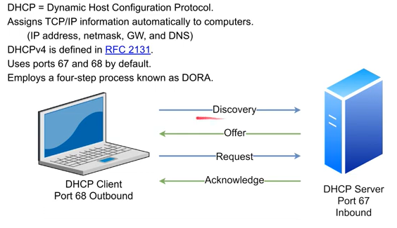
DHCP
The Complete Guide to Linux System Administration

Slide 29
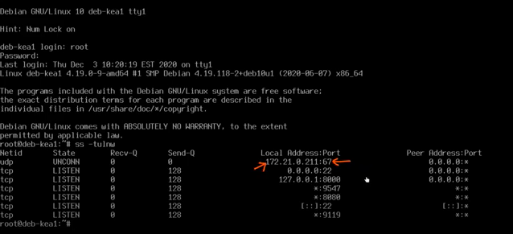
Default Ports
The Complete Guide to Linux System Administration

Slide 30
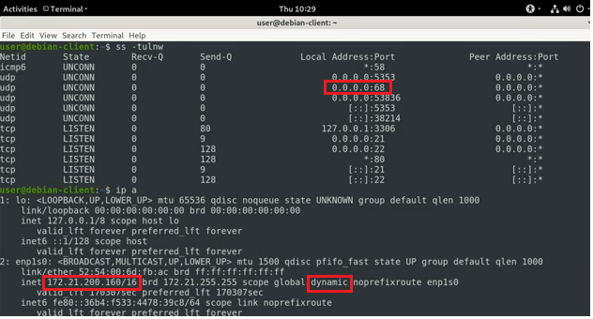
DHCP Assignment
The Complete Guide to Linux System Administration

